Slide 1
Sallary gap prediction final
Dor Bank, Shiran Mazor, Eylon Saadon

Slide 2

Business goal
Reduce gender wage gap among the OECD
Discover non trivial dependencies
Prediction task
Wage gap average among the OECD states
Averaging state predictions
Research article:
“A meta-analysis of the international gender wage gap”
Doris Weichselbaumer, Rudolf Winter-Ebmer
http://www.economics.uni-linz.ac.at/papers/2003/wp0311.pdf

Slide 3
Dataset segements
Our preliminary data is:
World data bank – GenderStat.csv
http://data.worldbank.org/data-catalog/gender-statistics
The Gender Statistics database is a comprehensive source for the latest sex-disaggregated data and gender statistics covering demography, education, health, access to economic opportunities, public life and decision-making, and agency
The features statistics are arranged by years columns for each country
OECD data center – Gender wage gaps (csv)
The OECD data will be used as the predicted data, and we will try to build a model relying on the data from the world data bank.
Exploration for new data sets will occur after model evaluation if necessary.
OECD value meaning – the gender wage gap is unadjusted and defined as the difference between male and female median wages divided by the male median wages
At first, we will try to extract features solely from this data.

Slide 4
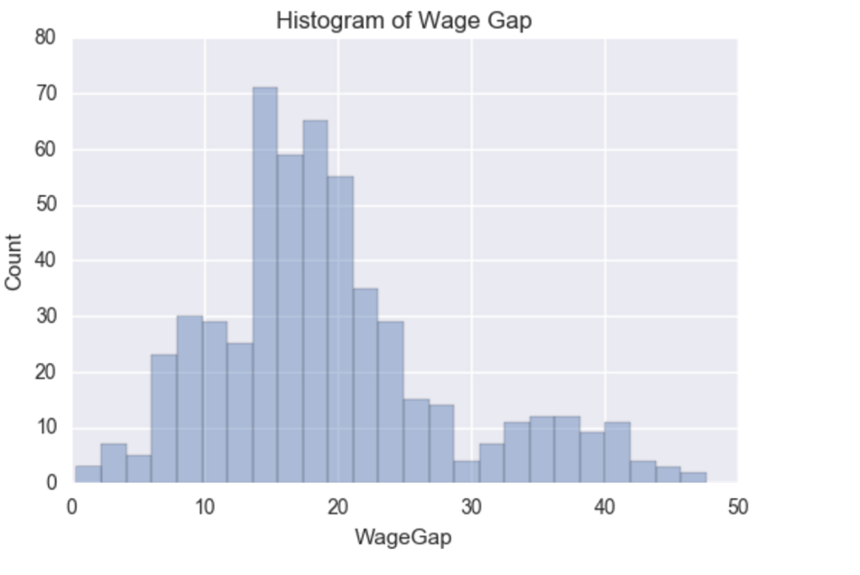
Data Preparation
Gender Stats CSV - Travers GenderStats rows to columns.
OECD Wage gap CSV - Add headers, Remove duplicate rows for the same year (Total and self employed in the same year for some countries).
Merge the two CSV’s – inner join Year and Country
Remove unnecessary columns
Specified Data Types
Convert country columns to binary indicators (treated as integers – {0,1})
All other features are float.
missing values
Column removal – set threshold at 90%
forward fill , backward fill
Normalized - Convert all values except the wageGap to be in range [0,1]. Chosen formula: value – min(value) / range(value)
Train-Test split
Train – all features before year 2010
Test – all features at years 2010-2016

Slide 5
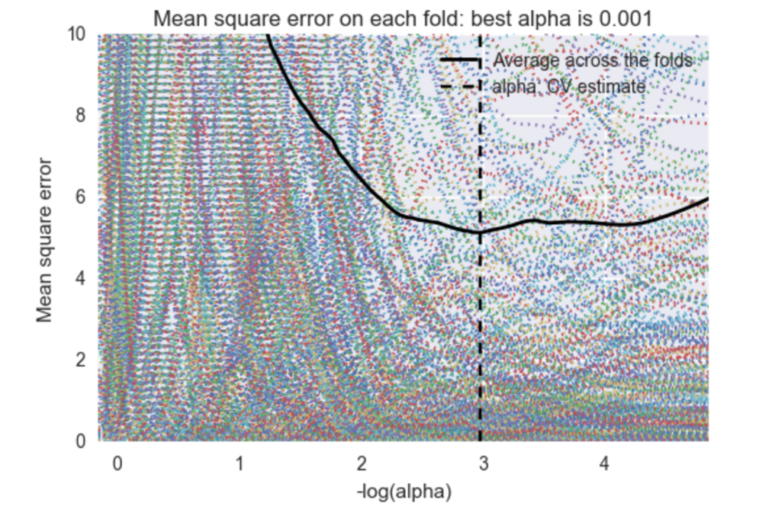
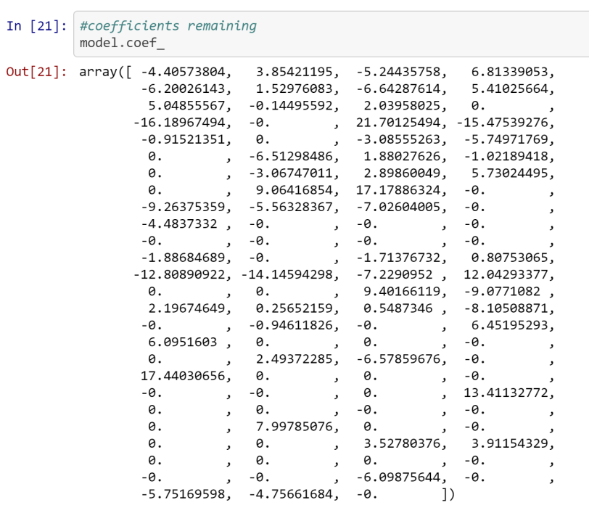
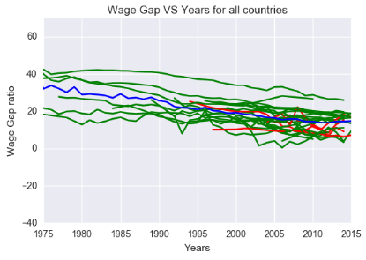
Data Modeling
Linear regression
L1 regularization (Lasso) – alpha chosen by LOOCV
Feature reduction
Initial “obviously” redundant features (683)
NA column removal (104)
Lasso (55, 24 countries) – removed year feature!

Slide 6
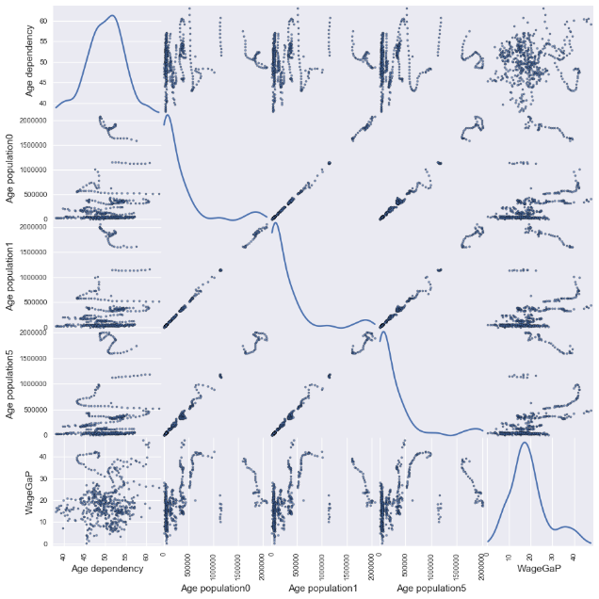
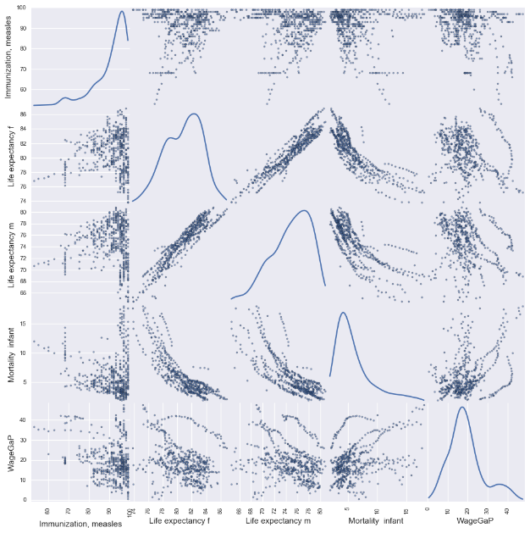
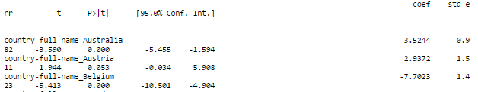
Feature Engineering - Correlations
Sklearn -> stats
Creating scatter matrix on a group of manually related features with Wage Gap
Engineer and reduce correlating features
T-test usage
Example: Age population 0\1\5 -taking the average of all of them.

Slide 7
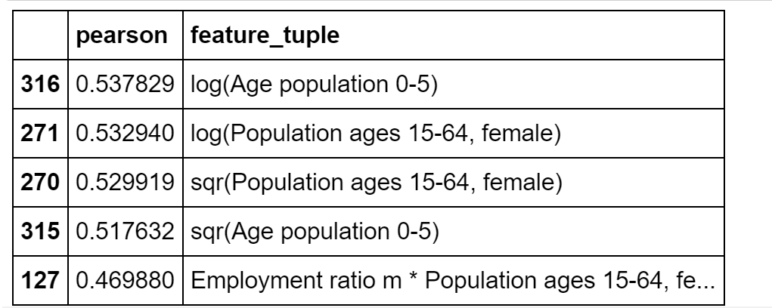
Feature Engineering - transformations
Cross term features
Sqrt, log & square of each feature
Using highest absolute pearson coefficient

Slide 8
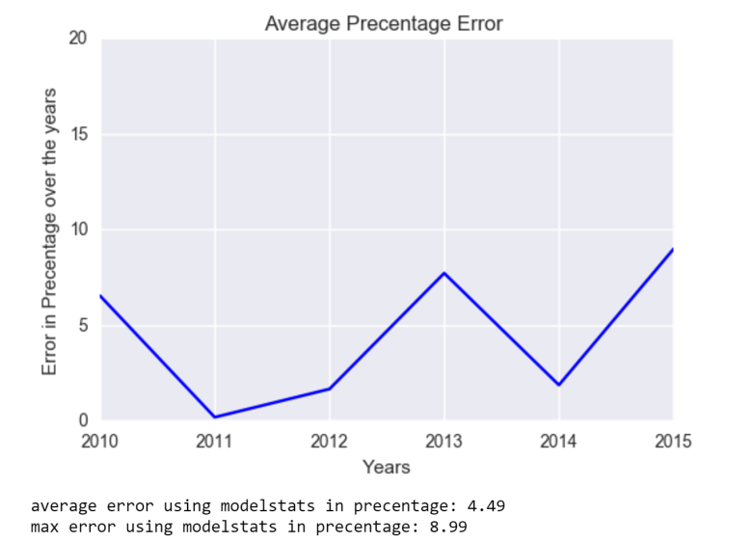
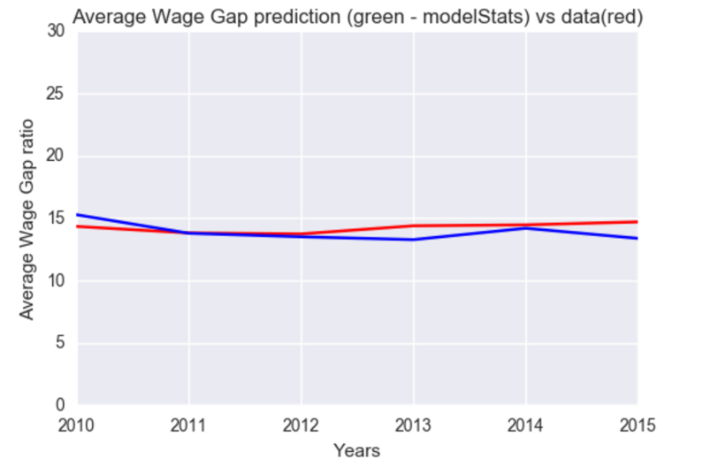
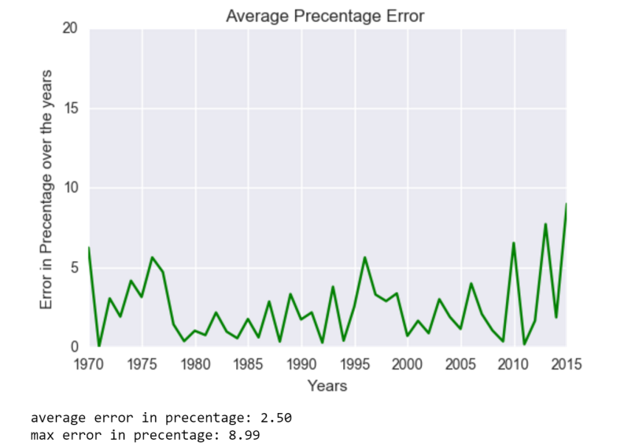
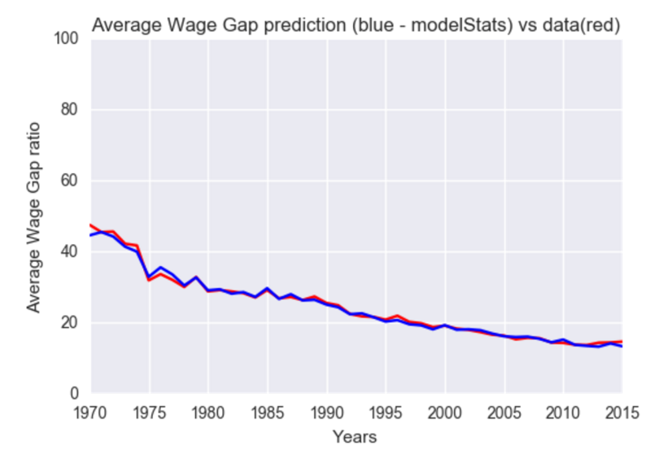
Model visualization and error

Slide 9
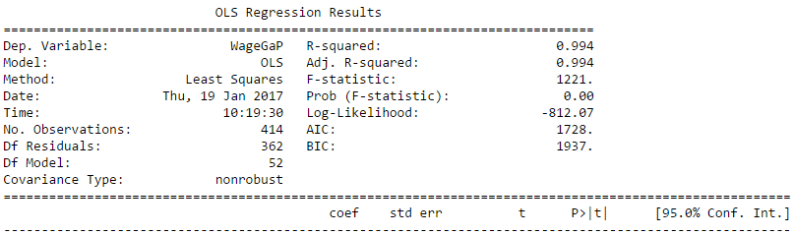
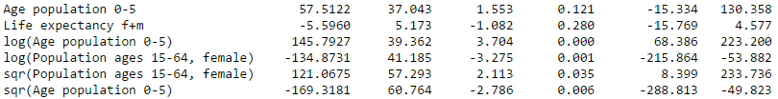
Modeling new Features
Using statsmodel to fit and predict wage gap with the new features list

Slide 10
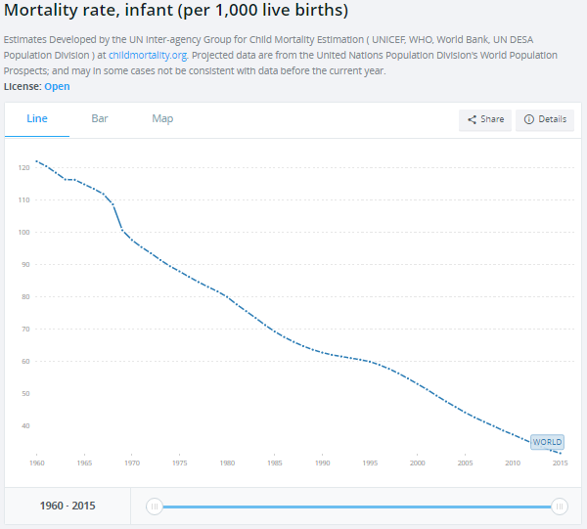
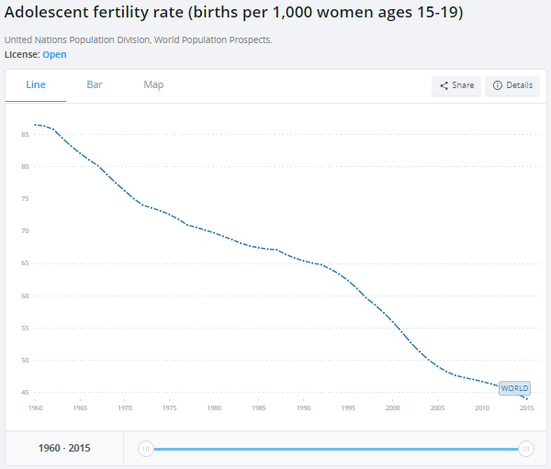
Conclusions & inference
The wage gap naturally diminishes through time
Time dependency – feature related
Mostly trivial important features, such as employment ratio,
Country differences
Non trivial features:
http://data.worldbank.org/indicator/SP.ADO.TFRT
http://data.worldbank.org/indicator/SP.DYN.IMRT.IN

Slide 11
Future prediction
Time dependency?
2 methods
First: fill 2016 country vectors, and average the predictions
Second: fill next wage gap
2 ways of filling next values: splines order 1,2
Results:
Method 2 | Method 1 | Spline order
12.08 | 17.95 | 1
16.55 | 19.49 | 2

Slide 12
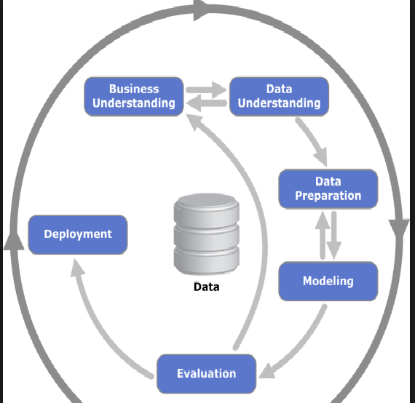
defining the ml problem
Data understanding
Data preparation & cleaning
Train –test split and normalization
Data Modeling using sklearn and statsmodel
Model Evaluation & Visualization
Correlations & features Engineering
New Data Modeling
Evaluation & visualization
Future prediction

Slide 13

Questions?

Slide 14
Features engineering (2)
Reduced features by correlations
Do not touch features with high t-test values
Age population 0\1\5 -taking the average of all of them.
Life expectancy - merge male and female with mean value.
Remove low t-test features – GDP\GNI per capita, country-full-name_Spain
Remove 8 features total.
Searching for a tuple with a product that has a linear correlation to WageGap new reduced

